Slide 1
Cloud Computing
AWS Project

Slide 2



Why Small Publishers Need Help?
Why Existing Tools Don’t Work:
Large Language Models (LLMs):
Expensive: High API costs and operational expenses.
Complex: Require advanced infrastructure and expertise.
Overpowered: Not designed for small-scale needs.
The Challenge:
Small publishers struggle to organize content effectively.
Impact:
No personalized recommendations.
Lower engagement.
Inefficient content delivery.
The Gap:
A simple, cost-effective tool is needed to automatically classify content in real time.
Must be accessible to small publishers and content creators.
XXX

Slide 3



NLP Solution Built for Small Publishers
Why the Cloud for
This Solution?
Our Solution:
Uses basic NLP algorithms with NLTK.
Lightweight: Avoids the complexity of LLMs.
Cost-effective: Designed for small businesses.
Interpretable: Delivers results that businesses can trust.
Automatic and Real-Time Processing:
Enables real-time content classification.
Cost-Effective:
Eliminates the need for expensive hardware.
Easy Updates and Integrations:
Seamlessly integrates with existing publishing platforms.
Empowerment:
Allows small publishers to organize content without advanced technical skills.

Slide 4
Model creation
Dataset
News Category Dataset (from Kaggle).
Tokenization: Split text into individual tokens.
Lemmatization: Reduced tokens to root forms (e.g., "running" → "run").
Feature Extraction
TF-IDF Vectorizer
Thousands of articles across 10 categories, such as politics, sports, and technology.
Preprocessing Steps
Stopword Removal: Removed common words like "the" and "is" to focus on meaningful terms.
Ensures rare but meaningful words are emphasized.
Solves the issue of common top words across categories.
Model Selection
LinearSVC (Support Vector Classifier):
Efficient for multi-class problems.
Handles high-dimensional data like text effectively.
Evaluation
Achieved 70%+ accuracy in classifying articles.

Slide 5




AWS Solution Overview
AWS Solution Overview
Provide a News Classification Service with the following features:
Hourly
Automated
Supports Concurrent Client Requests

Slide 6




AWS Infrastructure and Components
Our technical solution is implemented in 3 steps:
Step 1:
Set up and Configure the following 5 AWS Services
(1) EventBridge
(4) API Gateway to IP
Schedules Hourly Classifications:
Source: Google News RSS Feed
Target our EC2 instances
Rendering HTML file into browser
Setting up root and predict endpoints
Step 3:
Front and Back End Server Communication
(2) EC2 Instance
Step 2: Files in EC2 instance
(3) DynamoDB
(5) S3 (Bucket)
Stores ALL hourly categorized News Articles with 4 attributes:
News ID*
Title
Prediction
Timestamp
Stores ONLY client requested news articles via the browser
Records the timestamp of request

Slide 7
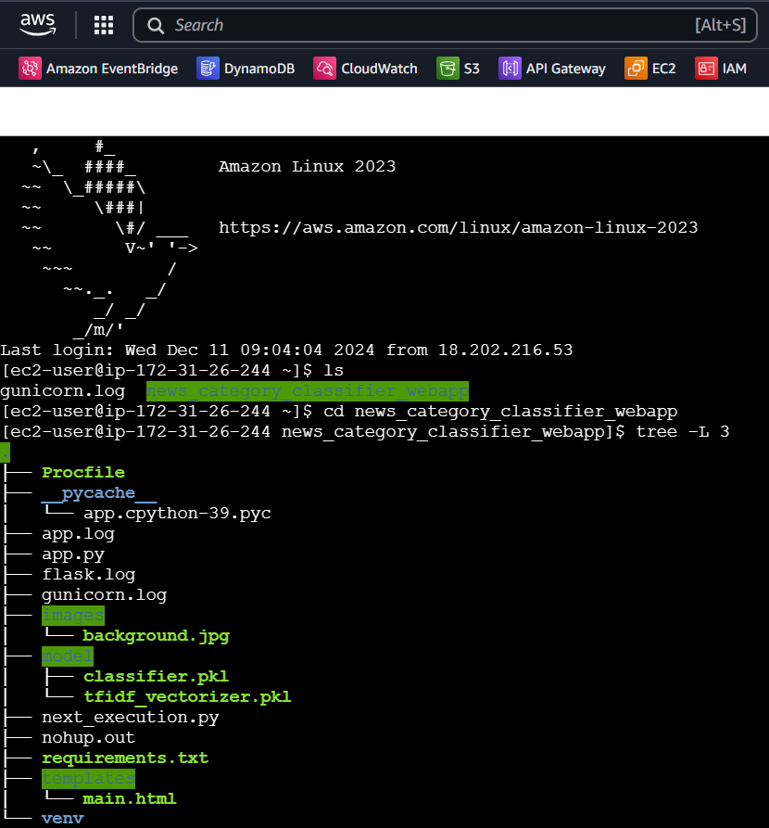


Dependencies and Preparation
Step 2:
Uploading of Offline Files into EC2 instance
1
Pickle Files from Offline Python Notebook:
Trained NLP Model Classifier
Word Vectorizer
2
Requirements.txt
Boto3 SDK → For DynamoDB and S3
Feedparser and APScheduler → For hourly feed parsing
App.py:
For Flask App
Functions to HTML file
3
Main.html:
Front-end UI Display on an API for the end user
4

Slide 8












Deployment into Prod Environment
Step 3: Set up front and back-end
Server Communication
NGINX as our production server
Helps to balance our unpredictable load for news parsing
Acts as a reverse proxy back to HTTP
Gunicorn as our API Gateway server
Helps to handle concurrent client requests
Ready for Deployment in Production

Slide 9




Data Flows Between AWS Components
1
EC2 to DynamoDB:
Function to automate classification and store in DynamoDB
(1) EventBridge
(4) API Gateway to IP
2
‘GET’ request from the API root endpoint:
Function to scan DynamoDB to fetch the last 1-hour news from current time
3
POST request to API predict endpoint:
This returns the last 1-hour news onto the browser
Stores this snapshot results into an S3 bucket that is timestamped
(2) EC2 Instance
(3) DynamoDB
(5) S3 (Bucket)

Slide 10

Model Results and Evaluation
Category | Accuracy
Business | 83%
Entertainment | 59%
Food & Drink | 74%
Parenting | 69%
Politics | 62%
Sports | 88%
Style and Beauty | 73%
Travel | 70%
Wellness | 74%
World News | 71%
Achieved consistent results with metrics ranging between 70% and 73% using LinearSVC.
This approach avoids complex deep learning techniques, offering a practical and effective solution for smaller publishers.
Metrics Used:
Accuracy: ~72%
Precision: ~73%
Recall: ~72%
F1-Score: ~72%
Confusion Matrix: ~73%
Performed cross-validation, confirming the model's stable and consistent performance.
XXX

Slide 11
Solution Features for Users
Feature #1: Hourly Snapshots on Request → S3
Retrieve all categorized news from the past hour with one click. These updates are stored in S3 for easy and reliable access.
Access by Users
Incoming News
Feature #2: Automated Categorization → DynamoDB
News articles are automatically categorized every hour and stored in a DynamoDB database. Users can query specific news updates from past hours anytime.
Stored in S3 & DynamoDB
Categorization
Feature #3: Scalability for Multiple Requests
Our solution handles multiple requests simultaneously with hourly categorized updates, ensuring reliability for all users
Empowering users with real-time updates and scalable solutions

Slide 12
Live Demo http://18.203.94.4:8080/

Slide 13
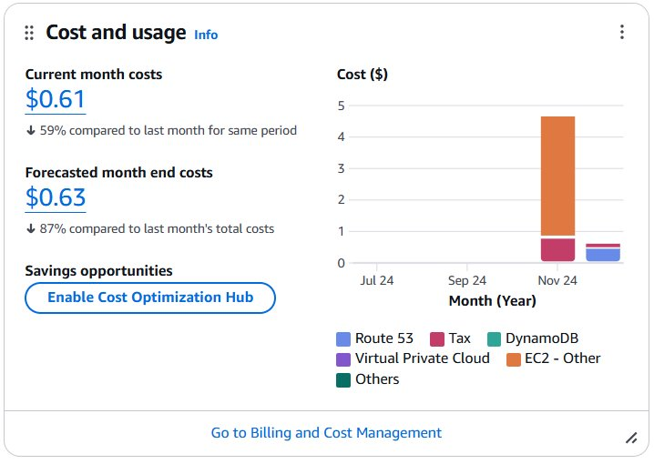
Key takeaways
Impact of the solution:
Ability to handle large-scale, real-time data classification and storage it
Adaptability and cost-effectiveness further underscores the suitability of this solution for small-scale publishers
Scales to include multiple news sources using the combined power of nginx and gunicorn​
Future directions and improvements:
Enhance classification accuracy: Incorporate advanced models like BERT to achieve better semantic understanding and classify more nuanced news categories
Expande sources: Integrate additional news sources
Improve user interface: By including advanced features such as search tools and recommendations (Amazon Personalize)

Slide 15
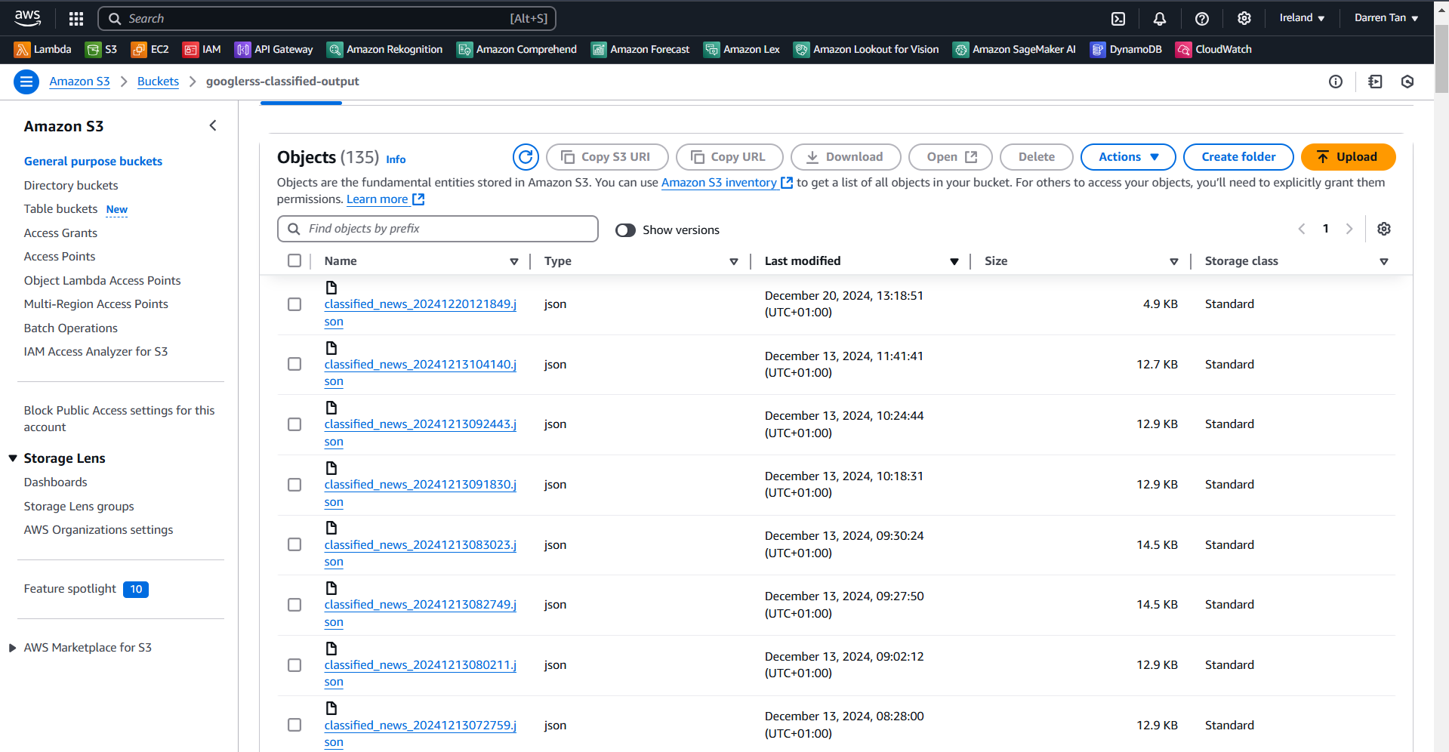

Slide 16
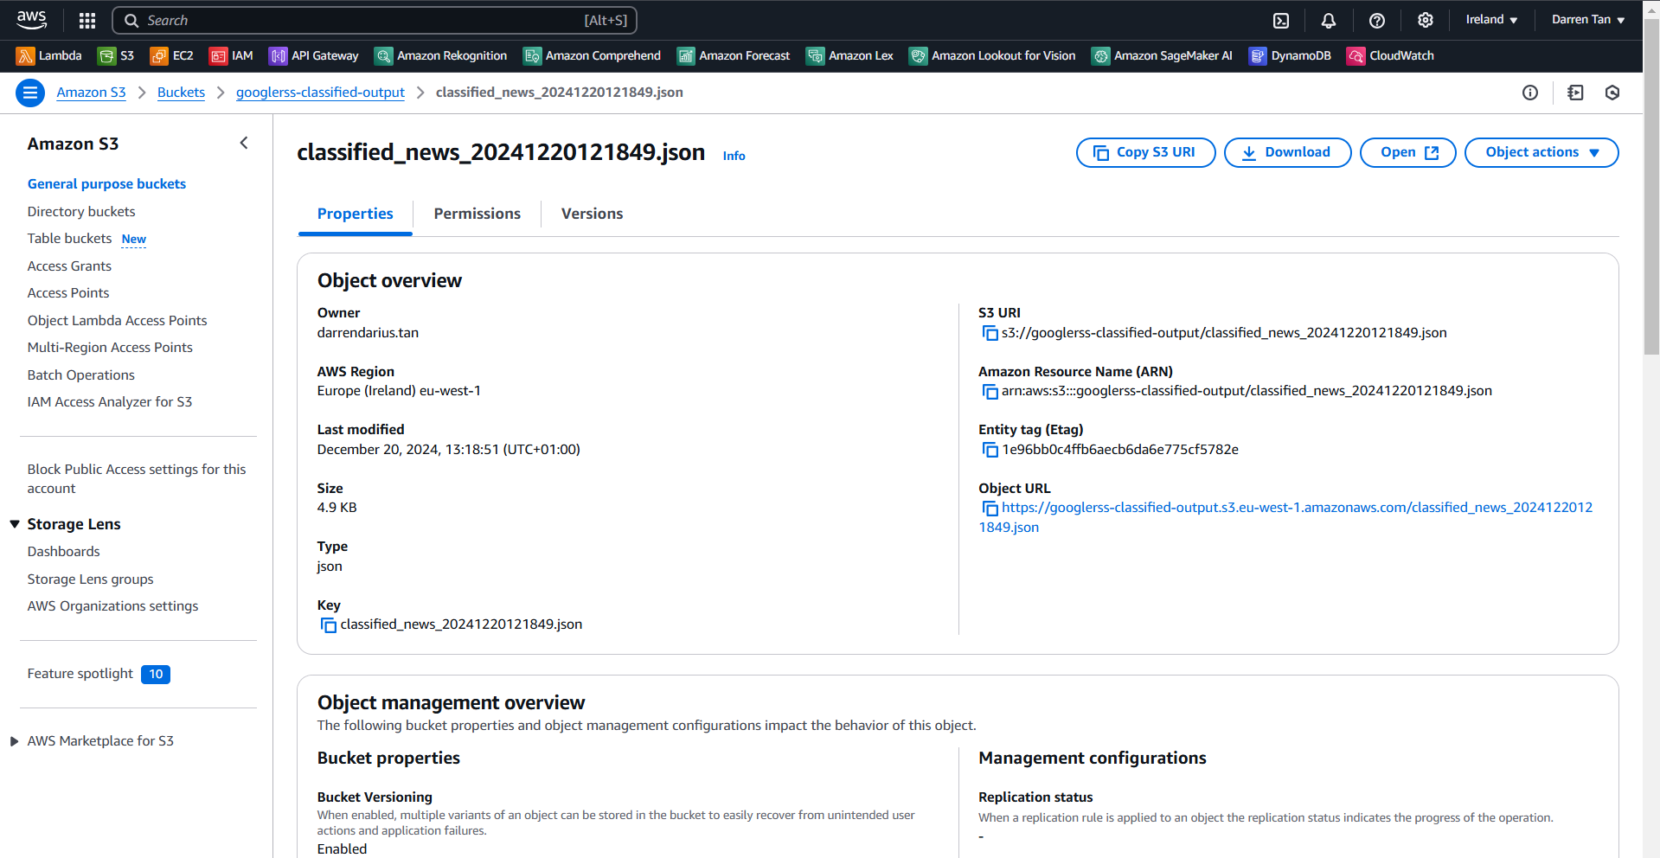

Slide 17
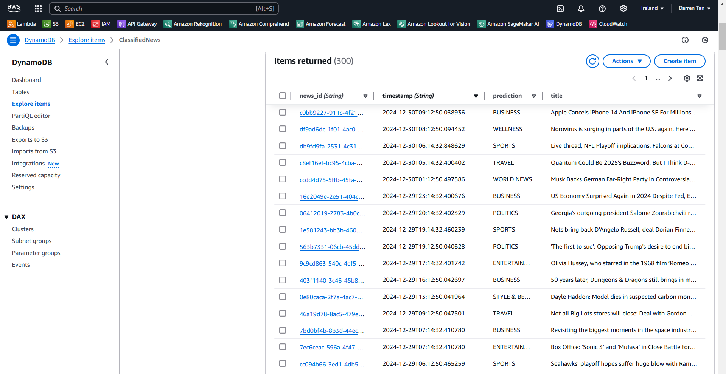

Slide 18
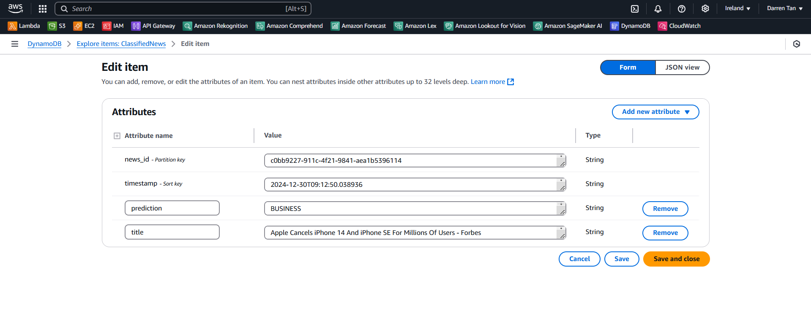

Slide 19
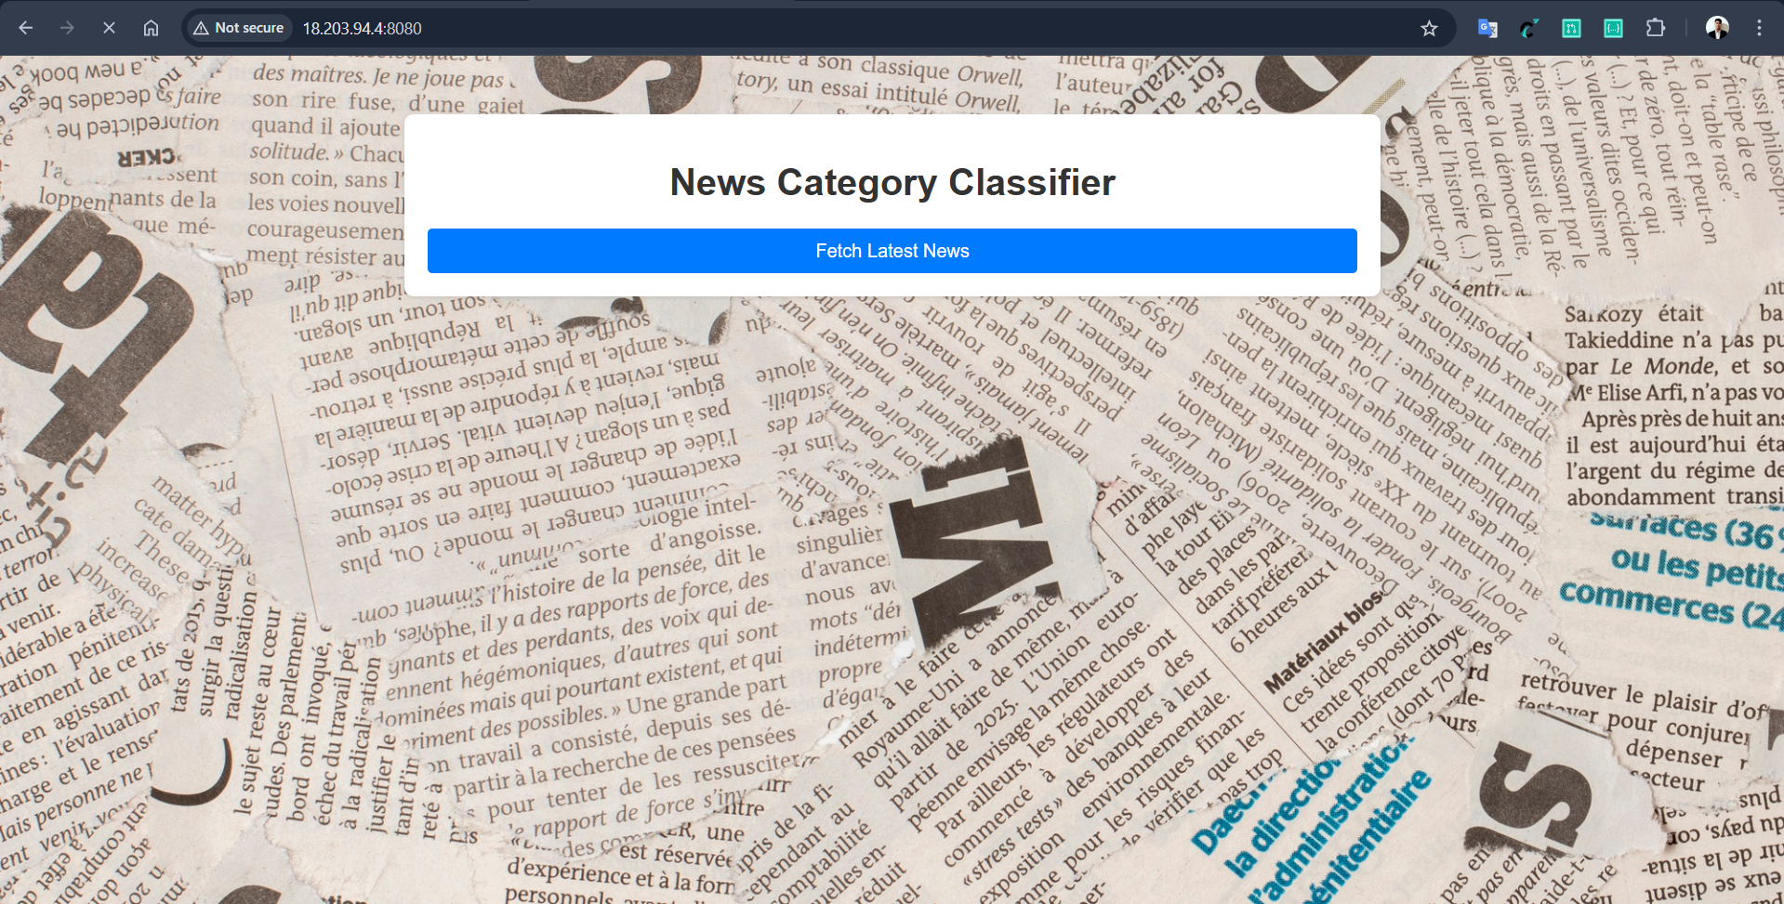

Slide 20
